Slide 1
unemployment and Real gdp
A visualization analysis
Alex, Clarice, Liufei, Kanika

Slide 2
01
research
Question
03 General
analysis
05 regression
02
cleaning
data
04
Group
analysis
06
conclusion

Slide 3
01.
research
question

Slide 4
Motivation
Okun's Law suggests an inverse relationship between changes in unemployment and changes in GDP
Essential for identifying how fluctuations in labor market conditions influence economic performance.
Study Purpose: uncover nuanced patterns that traditional aggregate analyses might overlook, providing a deeper insight into how labor market variations impact growth across different demographic groups.

Slide 5
Research question
How does the unemployment rate affect the real GDP growth rate across different continents, countries, sex, and age groups from 2014 to 2023?

Slide 6
02.
Cleaning data

Slide 7
DATA
GDP
UNEMPLOYMENT
Limit data to 2014-2023 range
Limit data to 2014-2023 range
Rename all inconsistent country names
Remove ‘Under 15’ category
Merge both data frames on ‘country’ index
Clean Data

Slide 8
MISSING DATA
GDP
UNEMPLOYMENT
Data missing for all years or fluctuate too much from year to year
Data missing essential demographic info needed for analyzation
Ffill, bfill, or interpolate will be inaccurate for analysis
Ffill, bfill, or interpolate will be inaccurate for analysis
Only 7 countries will be removed from the data, 2 of which are territories
Drop Data

Slide 9


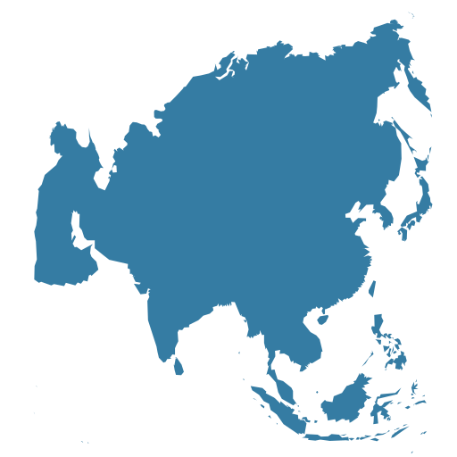


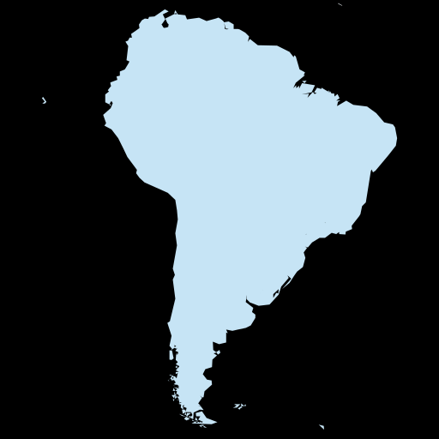
ASSIGNING COUNTRIES TO CONTINENTS
AFRICA: AF
ASIA: AS
EUROPE: EU
NORTH AMERICA: NAM
OCEANA: OC
SOUTH AMERICA: SAM
Countries at the border of Asia and Europe received AS/EU code
A total of 4 countries received AS/EU code: Georgia, Turkey, Russia, Azerbaijan
Initially coded as ‘NA’, but Python took it as missing data so re-coded as ‘NAM’
Coded as ‘SAM’ to mirror North America’s country code

Slide 10
03.
General
analysis

Slide 11
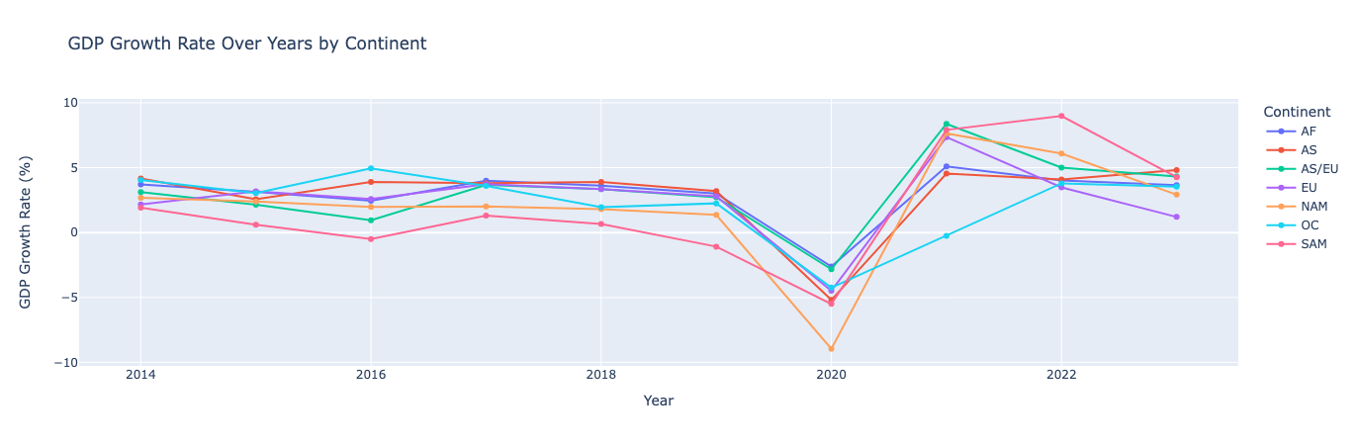
GDP Growth Against Time for Every Continent
The GDP Growth Rate % per continent seem to generally follow the same trend across all continents
All continents experiences a severe dip in GDP Growth Rate % in 2020 which can be attributed to the COVID-19 Pandemic
From 2020-2022 the continents experienced a hike attributing to the economic recovery efforts post-pandemic
In 2023, they all resumed to the initial growth rate% of 0-5%

Slide 12
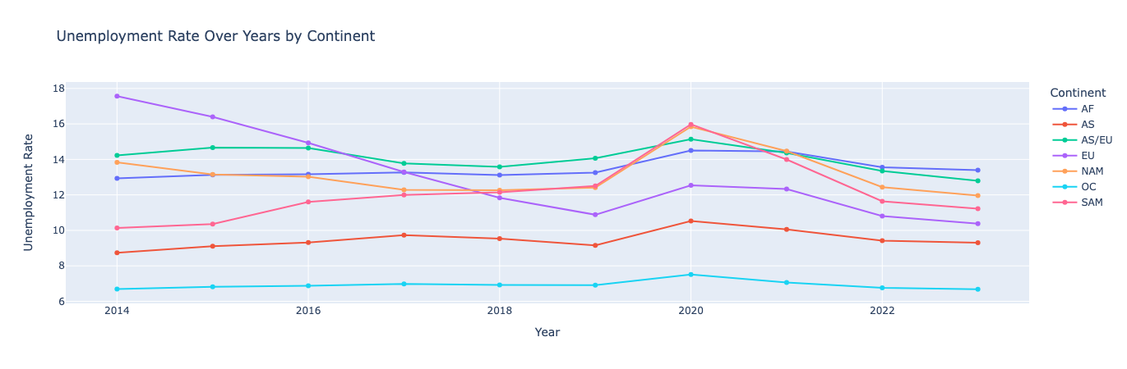
Unemployment Rate Against Time for Every Continent
The unemployment rates are significantly different across continents with Oceania and Asia having consistently low unemployment rates
The other continents seem to have more volatile changes in their unemployment rates. Europe experienced a drastic fall till 2019 which can be attributed to the recovery period from the Eurozone Debt Crisis
In 2020, in line with the COVID-19 Pandemic, all regions experienced a hike in their unemployment rates which is expected, followed by a decrease in subsequent years

Slide 13
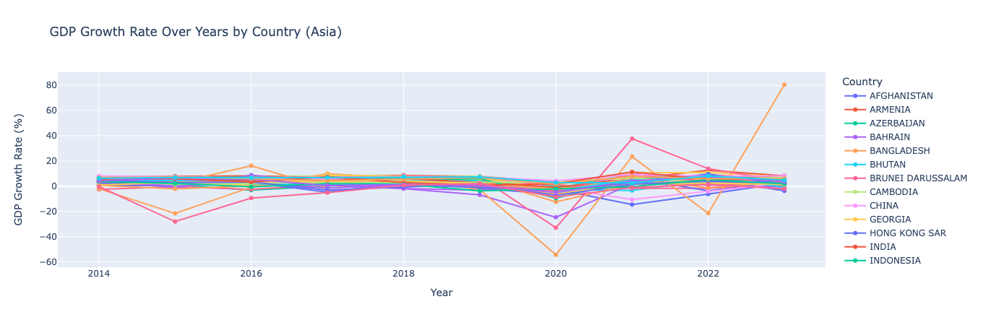
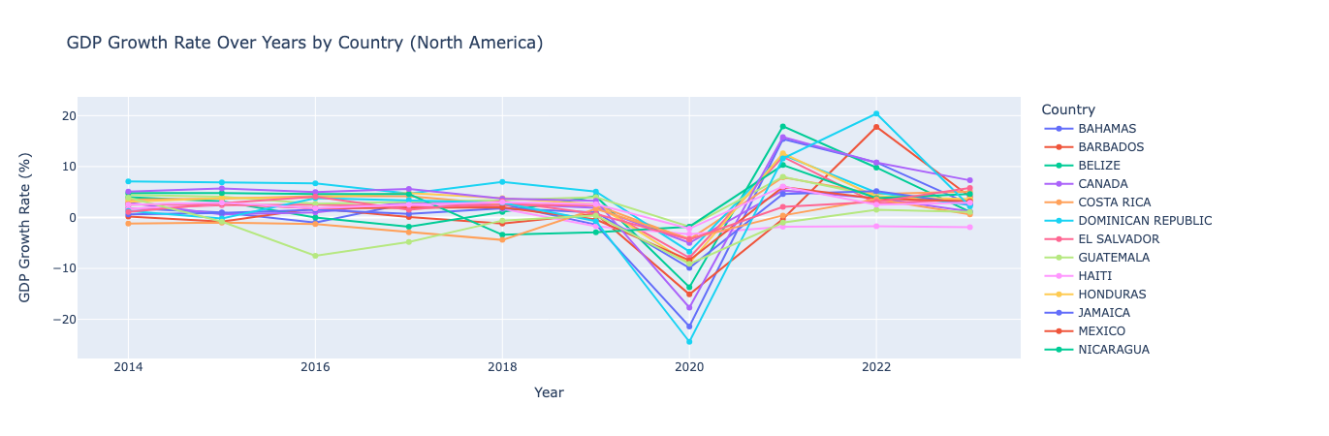
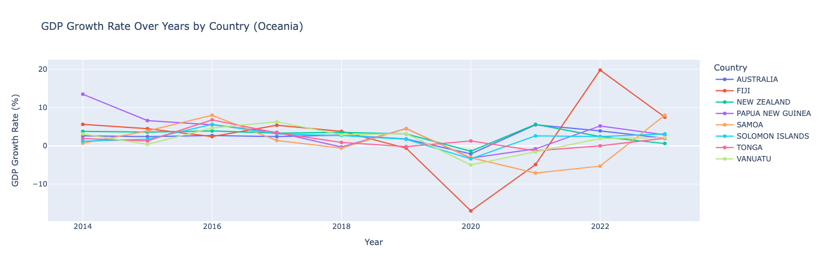
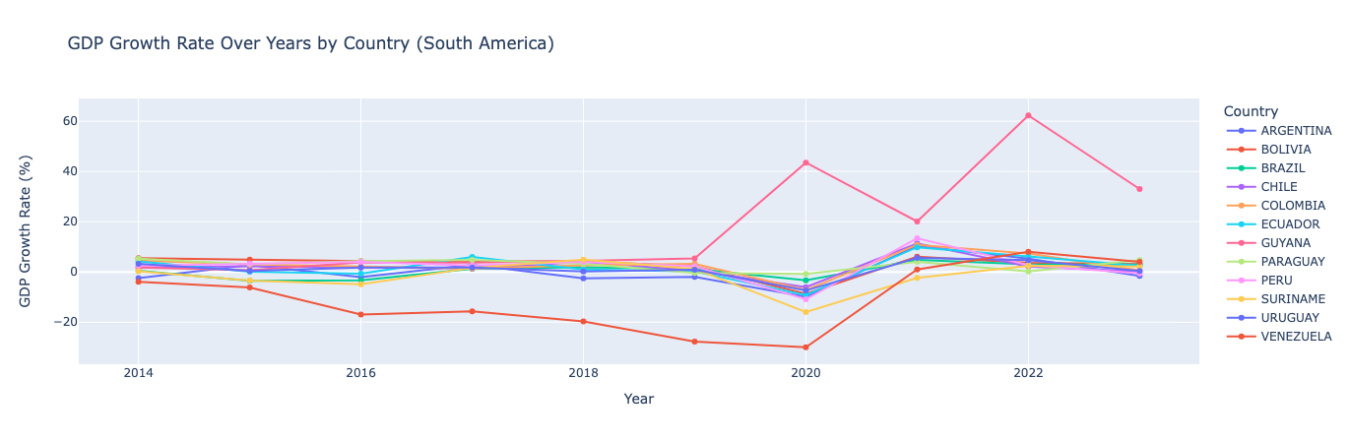
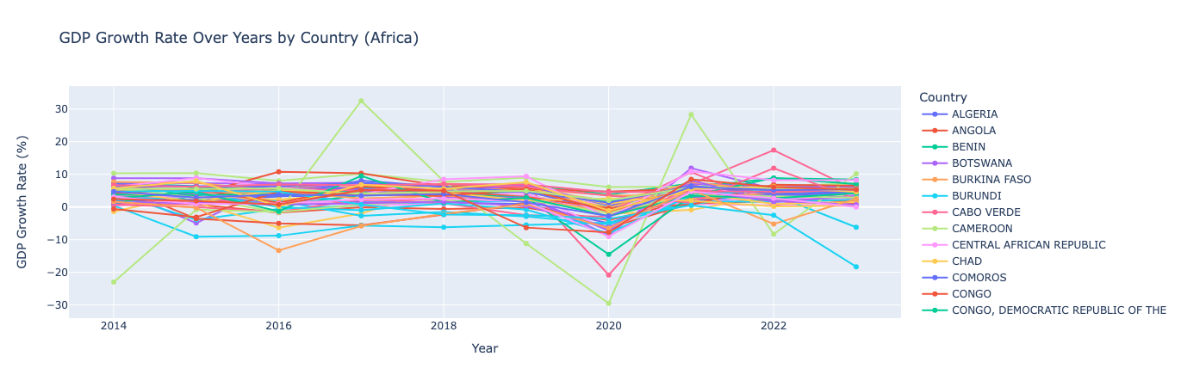
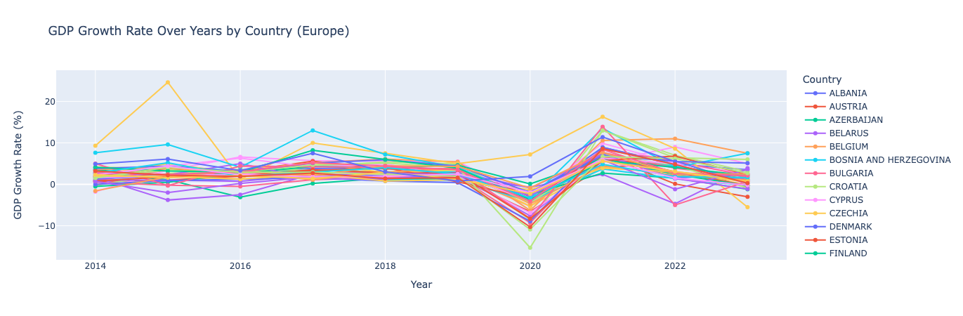
GDP Growth Rate By country [per continent]
ASIA
North america
oceania
south america
africa
europe

Slide 14
GDP Growth Rate By country [per continent]
Country lines tend to be close to each other indicating similar values and similar trends across years
As expected, sharp decrease in 2020 due to the pandemic
Recover post-pandemic show significant variation in different countries

Slide 15
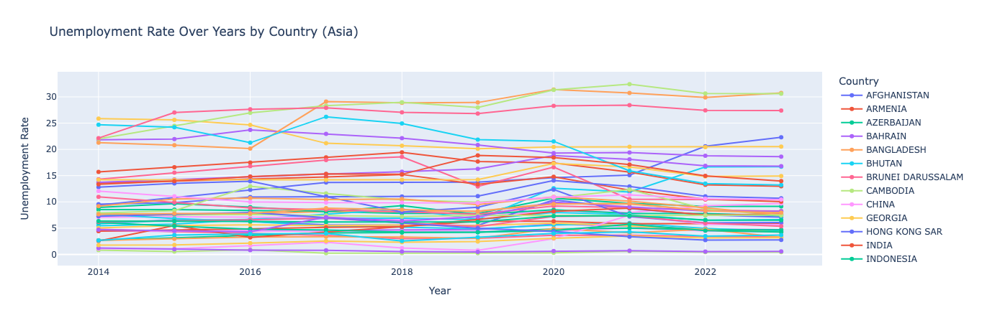
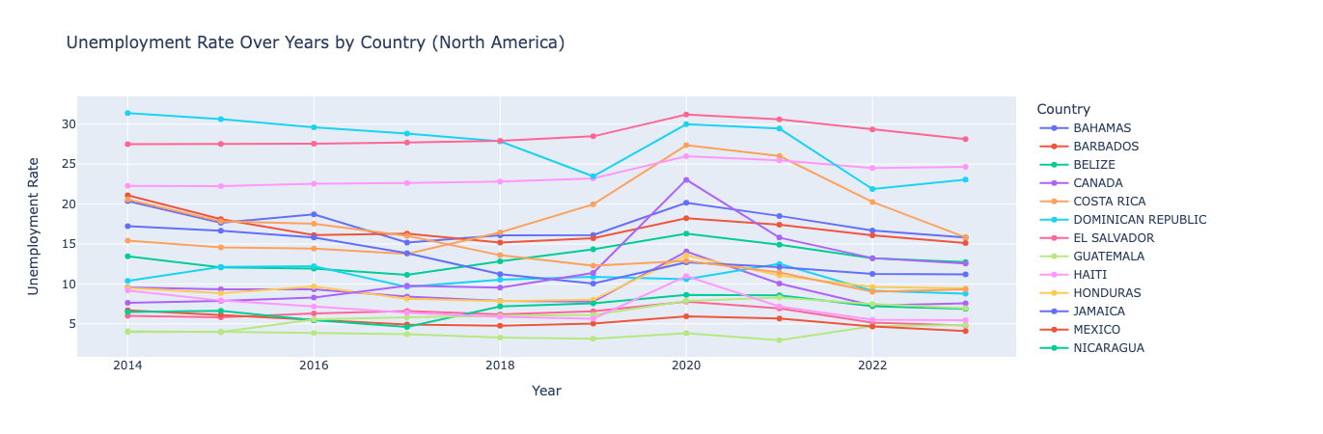
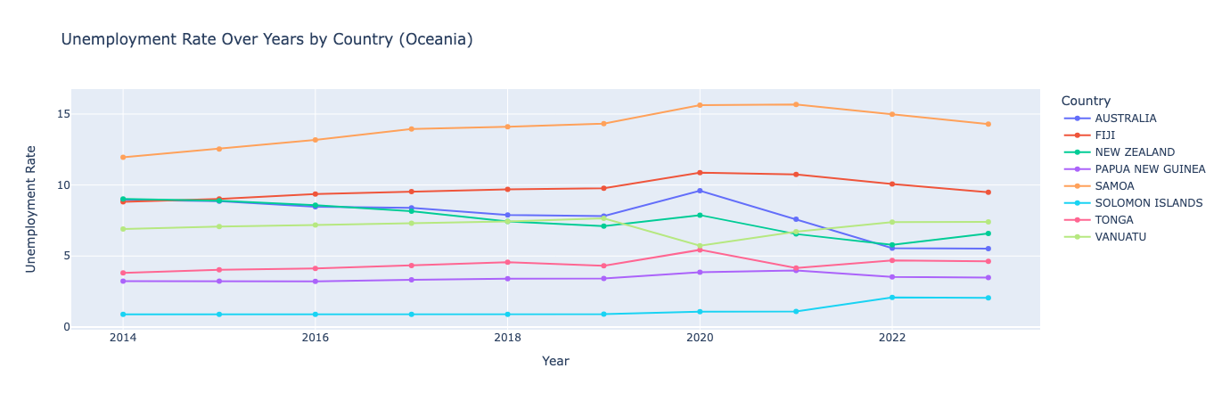
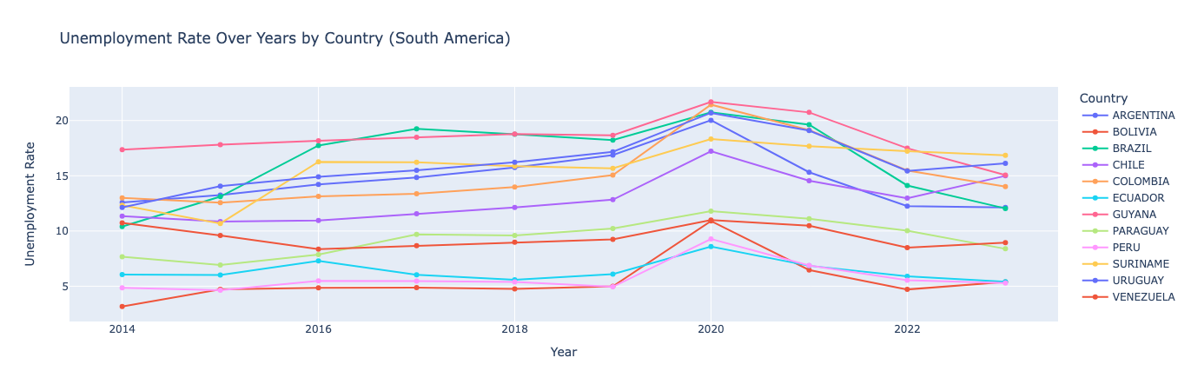
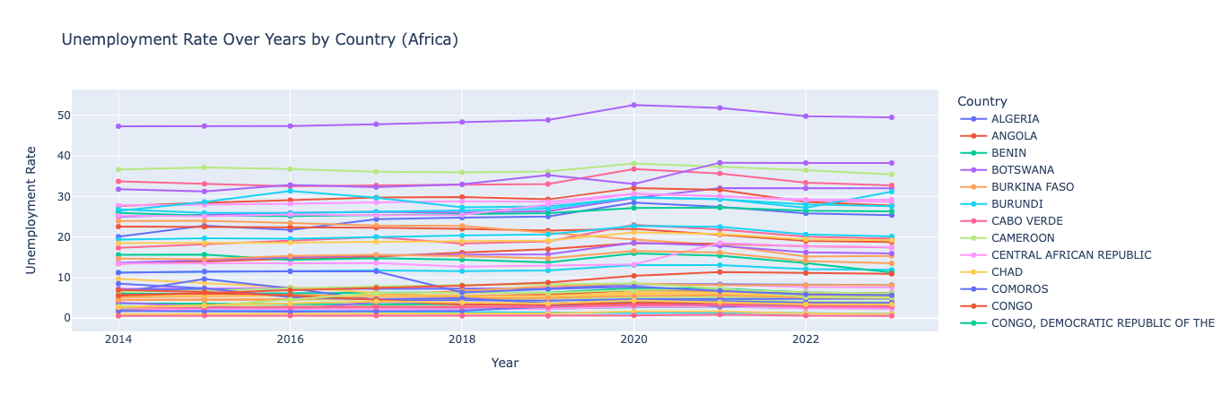
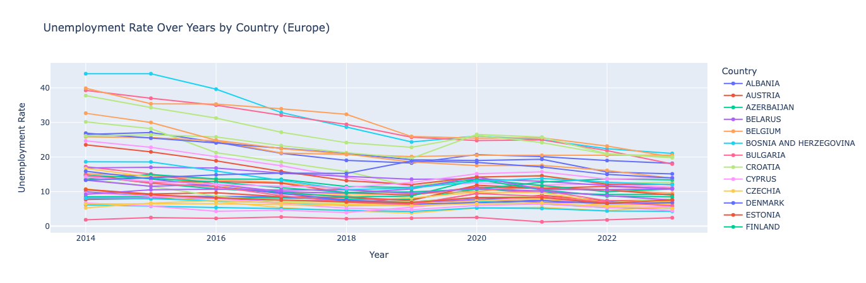
unemployment Rate By country [per continent]
ASIA
North america
oceania
south america
africa
europe

Slide 16
unemployment Rate By country [per continent]
Country lines have significant difference and are extreme per continent
General increase during 2022 due to the pandemic
Country unemployment rates post-pandemic are very different from each other as can be seen through overlapping lines. This could be attributed to the different economic policies undertaken by the country’s government

Slide 17
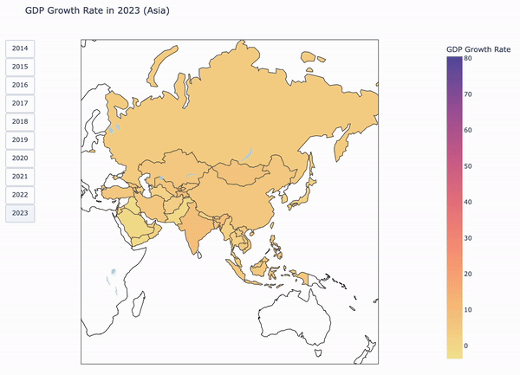
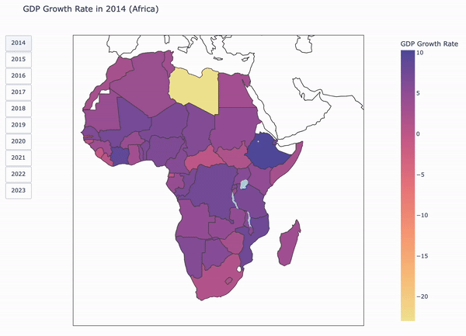
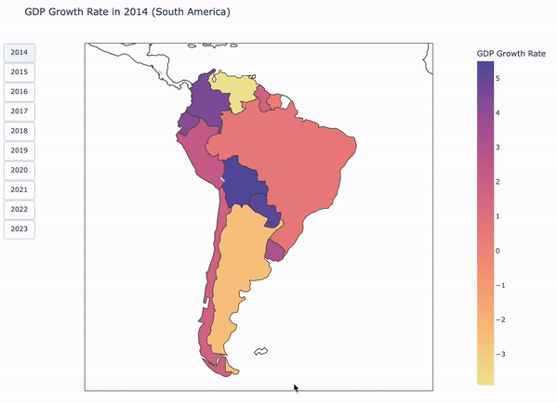
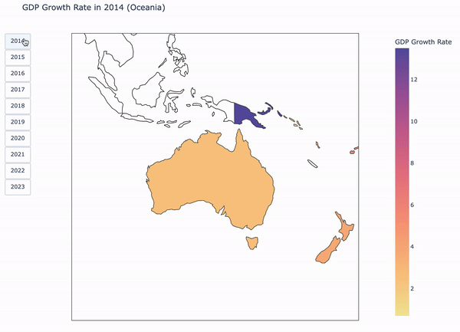
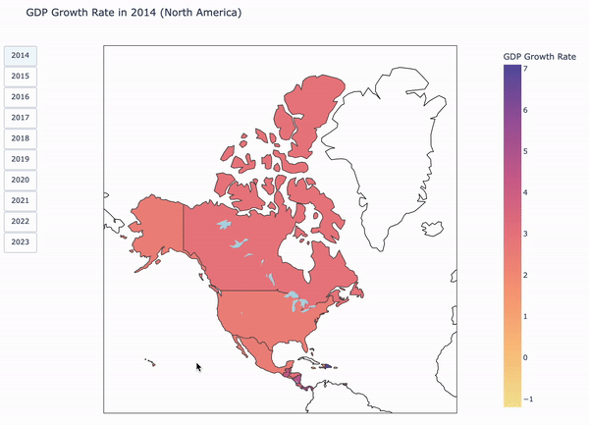
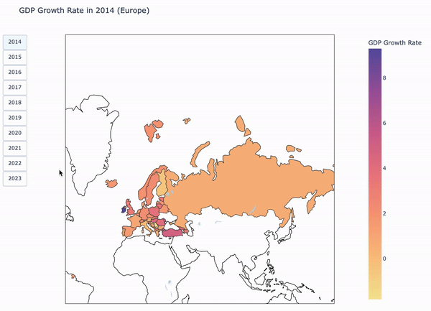
GDP GRowth rate per country per continent geographically
ASIA
AFRICA
SOUTH AMERICA
OCEANIA
NORTH AMERICA
EUROPE
A general theme observed across all regions is that the countries that are dark (indicating high economic rates) remain on the darker side of the spectrum across time
However, in 2020, all countries had a downward spike in their GDP rates
After 2020, as countries are improving their economy the rate is more similar across countries as compared to before the pandemic.

Slide 18
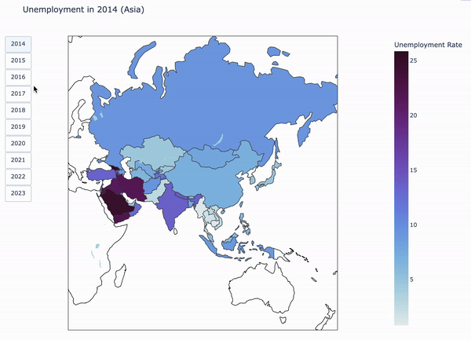
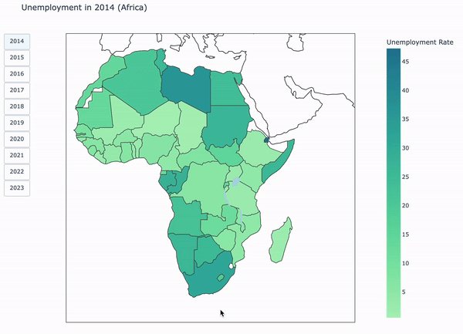
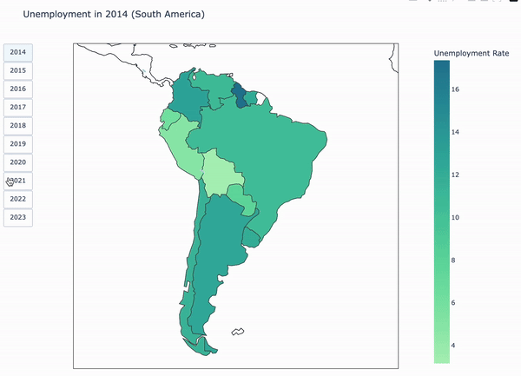
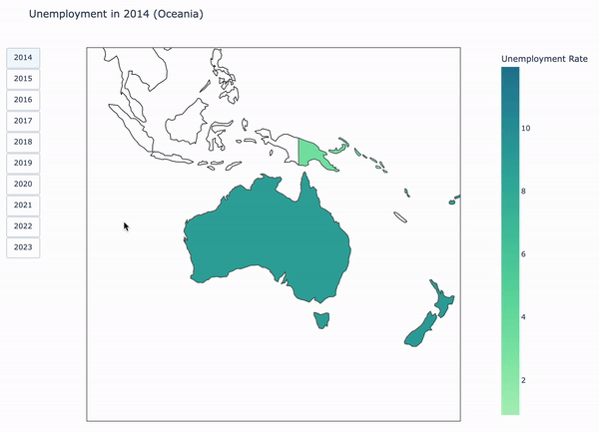
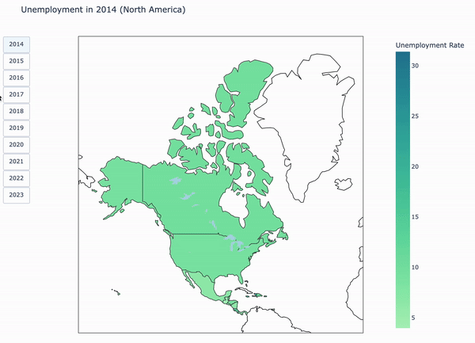
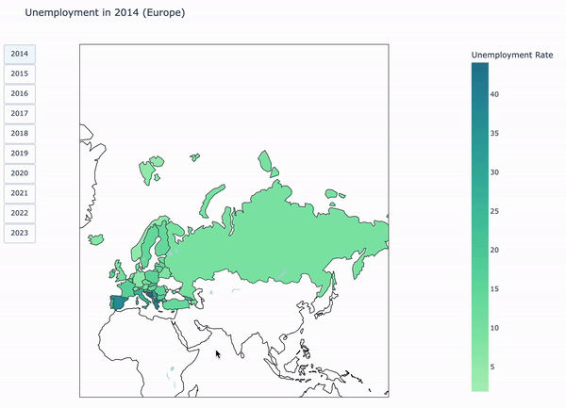
unemployment rate per country per continent geographically
ASIA
AFRICA
SOUTH AMERICA
OCEANIA
NORTH AMERICA
EUROPE
A general theme observed across all regions is that there is a spectrum of countries across the color range
Despite the variation, Countries in similar geographical regions tend to have similar unemployment rates
Countries with high unemployment rates were affected the worst during the pandemic

Slide 19
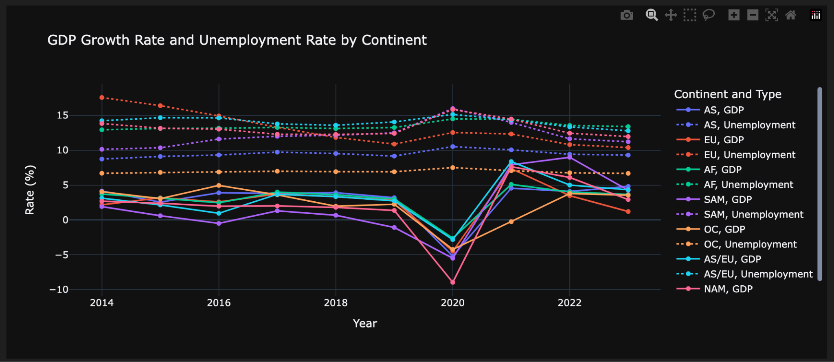
Time series of GDP Growth Rate and Unemployment Rate by Continent
There is a steep downward sloping in GDP Growth Rate and an upward sloping in Unemployment Rate in 2020
There is likely a negative correlation between GDP and Unemployment Rate

Slide 20
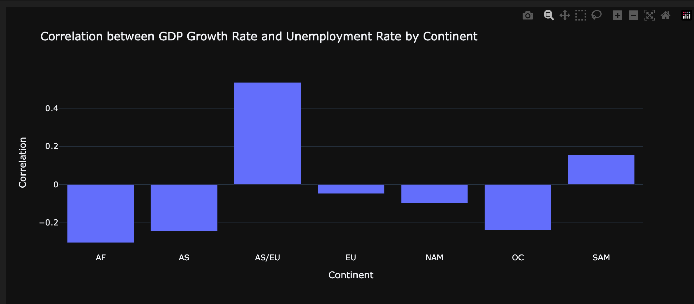
Bar chart of Correlation between GDP Growth Rate and Unemployment Rate
There is a negative correlation between GDP growth rate and unemployment rate in most of the countries, indicating that as GDP growth rate increases, unemployment rate tends to decrease. This relationship is stronger in continents with higher poverty levels and is weaker in North America and Europe.
Anomaly: there is a positive correlation in AS/EU and South America area

Slide 21
Anomaly analysis: South america
Agricultural Employment Share:
The higher the proportion of agricultural employment, the less sensitive the unemployment rate is to GDP growth.
Informal Employment:
A high proportion of informal employment reduces the impact of economic fluctuations on the unemployment rate.
Labor Market Protection:
Employment protection laws have no significant impact on Okun’s coefficient.
Unpaid Family Labor:
This type of work typically increases during economic contractions and exhibits countercyclical characteristics.

Slide 22
04.
group
analysis

Slide 23
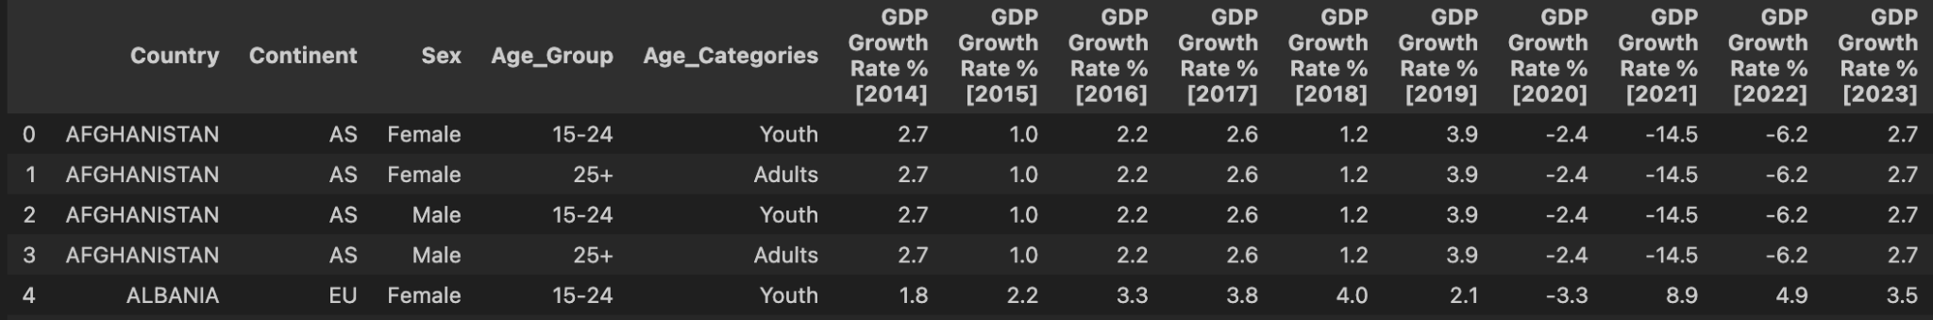
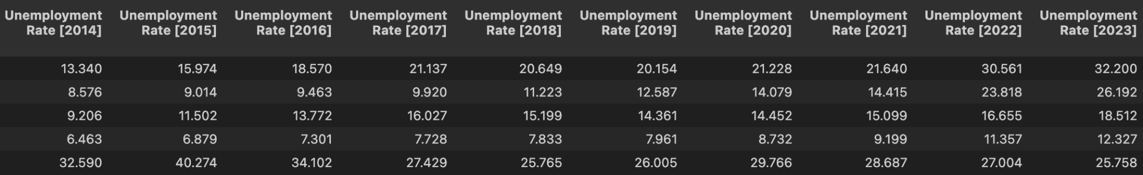
the relationship between unemployment rates and GDP growth rates across sex and age groups
Key Observations
GDP growth rate does not vary based on sex or age group within each country
The analysis of unemployment rates, which do vary across these demographics

Slide 24
SEx Group (Female : Male)

Slide 25
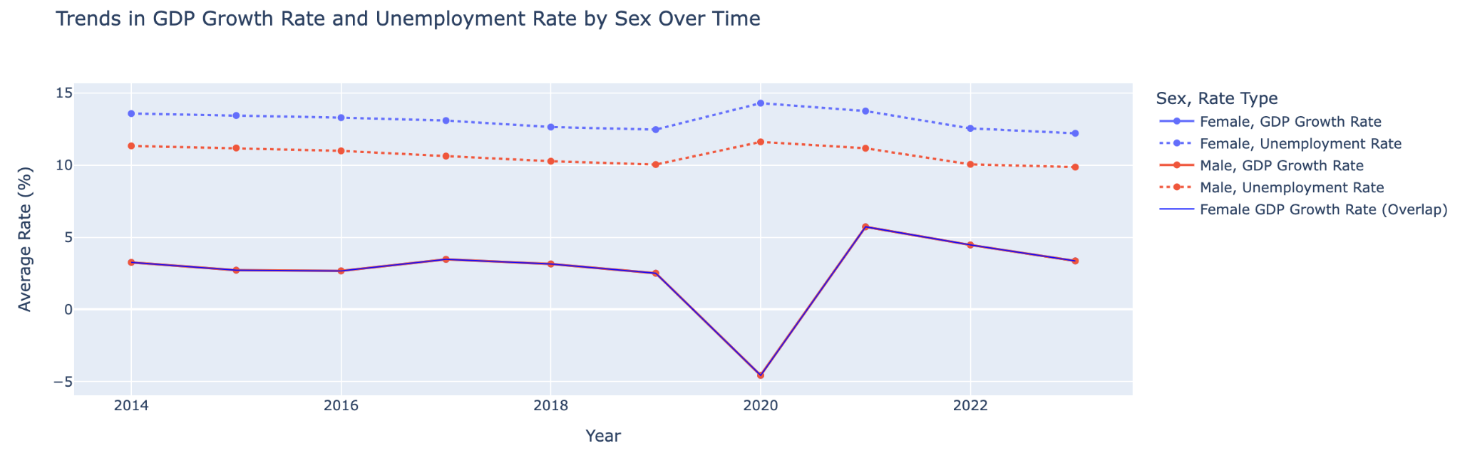
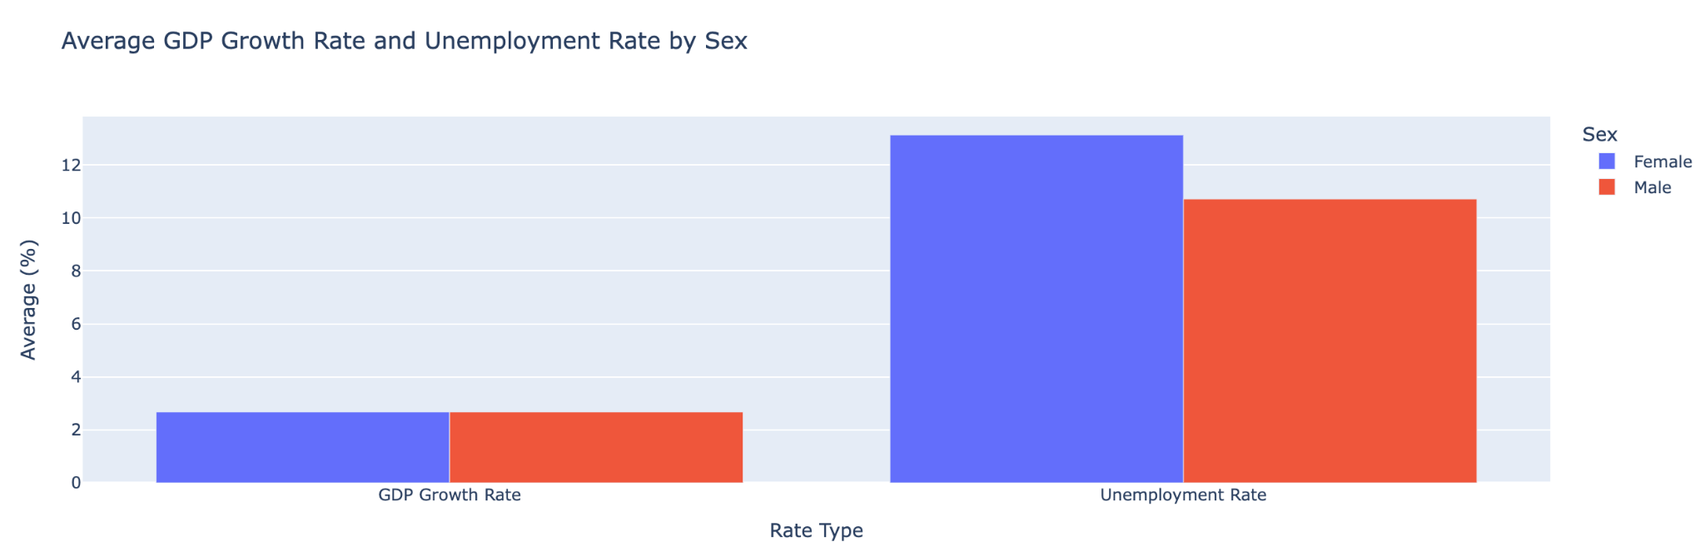
Line Plot & Bar plot
GDP GROWTH RATE
The GDP growth rate is identical for males and females throughout the observed period
There is a sharp dip in 2020, likely reflecting the economic impact of COVID-19
UNEMPLOYMENT RATE
Females consistently have higher unemployment rates compared to males across all years
Both male and female unemployment rates show a gradual recovery post-2020.
GDP GROWTH RATE
The average GDP growth rate is identical for males and females at 2.68%.
This reinforces that GDP growth in the dataset does not depend on sex.
UNEMPLOYMENT RATE
The average unemployment rate for females (13.13%) is significantly higher than for males (10.72%).
This highlights potential disparities in employment opportunities or workforce participation.

Slide 26
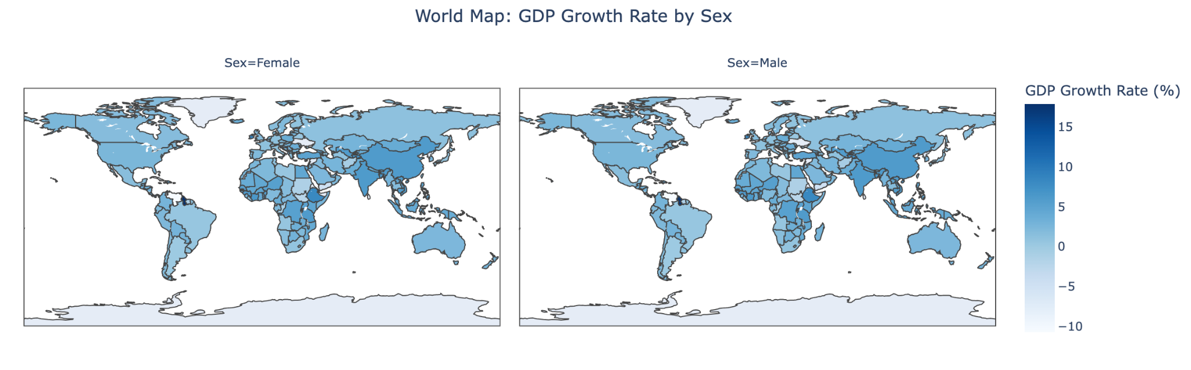
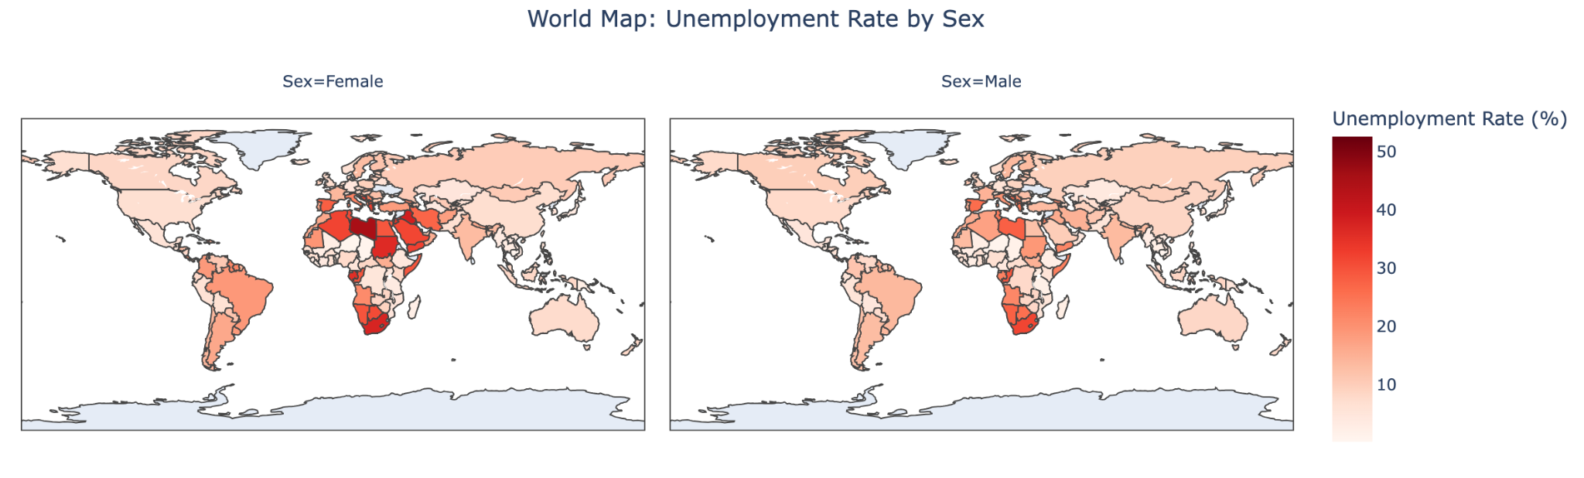
World Map
The GDP growth rates are aggregated at the national level, with no sex-specific variations recorded in the dataset.
The identical color scales confirm that the GDP growth rate is not influenced by gender within the dataset.
Ex: China(5.96%), Afghanistan(-0.68%)
The maps show disparities in unemployment rates by sex across countries, with females generally experiencing higher rates than males.
Ex: Female : Male
United States: 6.71% : 7.56%
South Africa: 37.24% : 31.59%

Slide 27
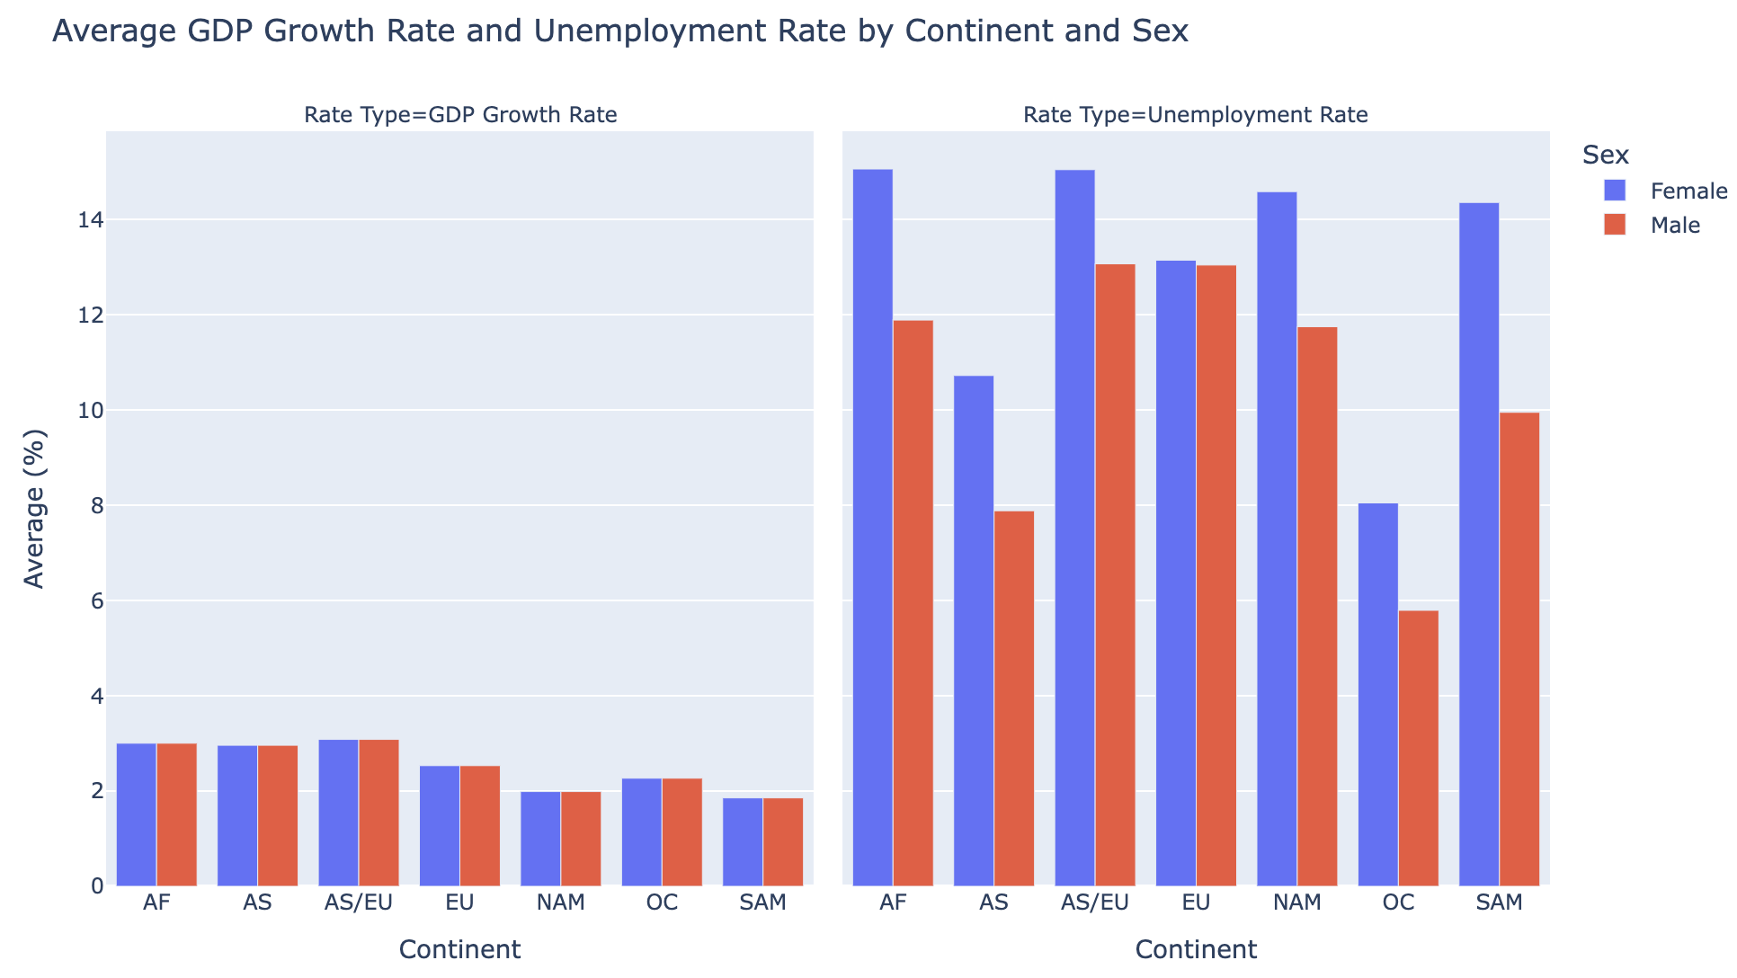
Average GDP Growth Rate and Unemployment Rate by Continent
GDP Growth Rate:
Consistent across sexes in all continents, reflecting no gender-based economic growth disparity.
Highest in Africa (3.00% for both males and females).
Lowest in South America (1.85% for both sexes).
Unemployment Rate:
Significant gender gaps observed.
Female : Male
Africa: 15.06% : 11.89%
Oceania: 8.05% : 5.79%
North America: 14.59% : 11.75%
Gender disparities in unemployment persist globally, varying by region.

Slide 28
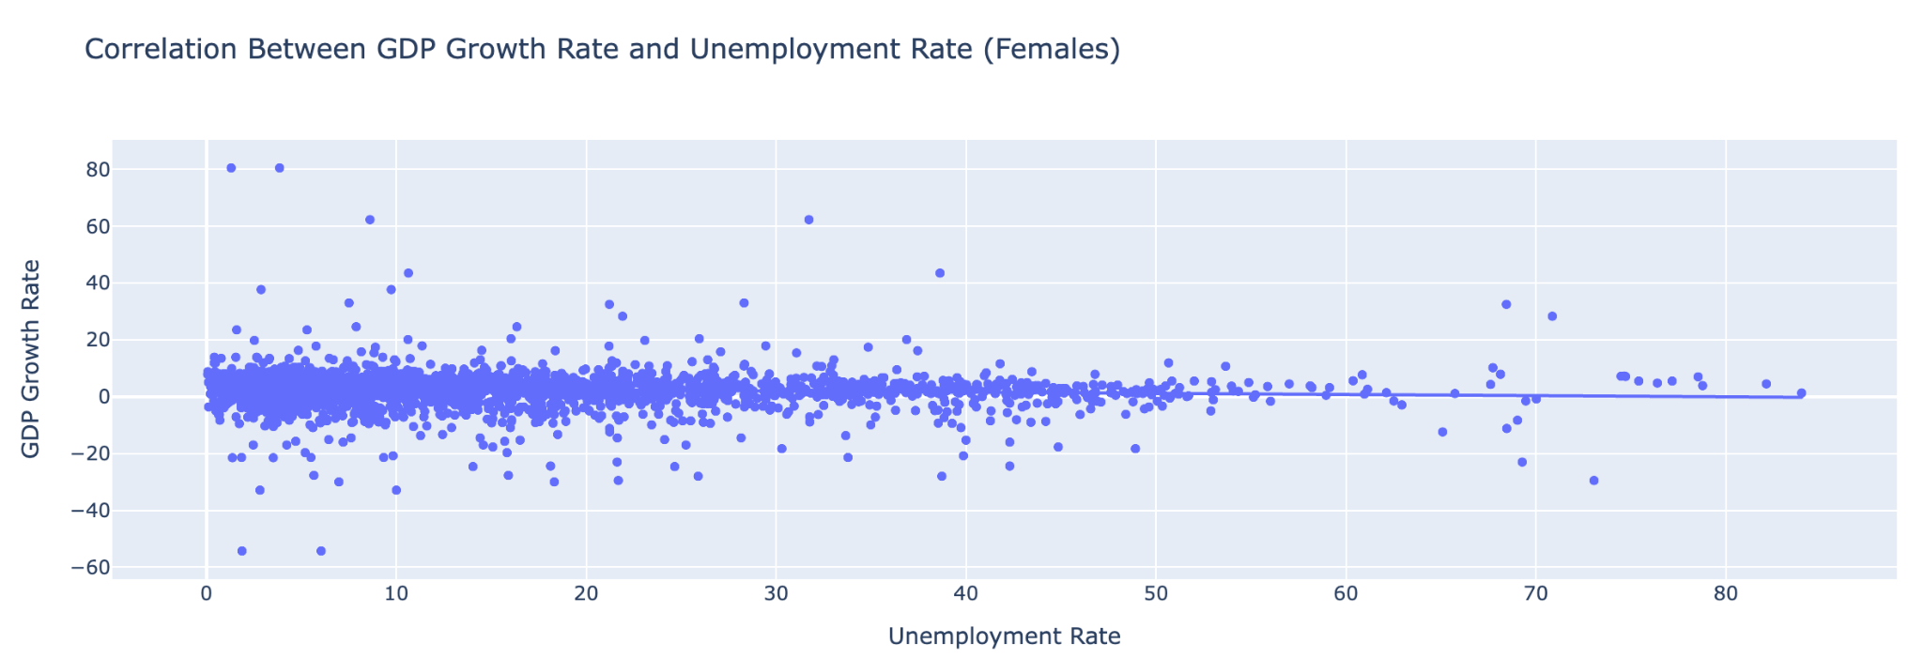
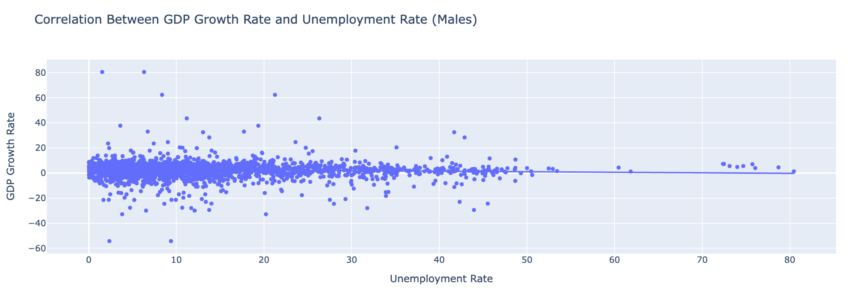
Correlation Analysis
Key Points:
Correlation Results:
For females, the correlation coefficient is -0.0905, indicating a very weak negative relationship between GDP growth and unemployment rates.
For males, the correlation coefficient is -0.0763, also showing a very weak negative relationship.
Visual Insights:
Scatter plots with trend lines for both sexes demonstrate a near-flat trend, reinforcing the weak correlation.
Conclusion:
The data suggests that changes in GDP growth rates have minimal influence on unemployment rates across both genders.

Slide 29
Age Group (YOUTH : Adults)

Slide 30
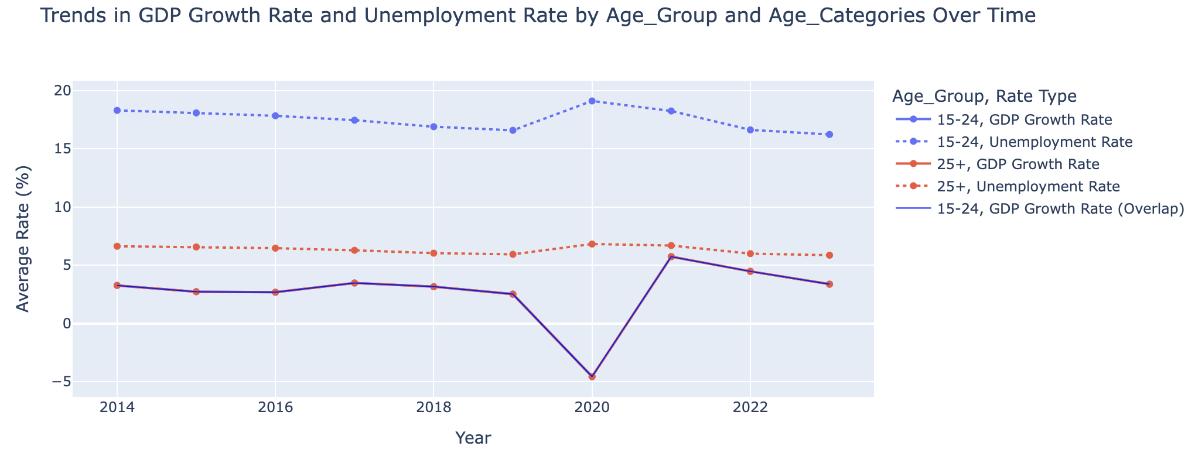
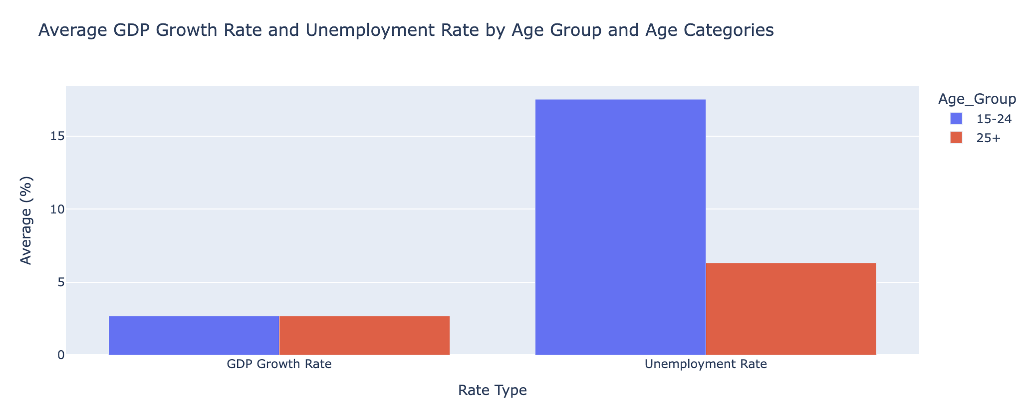
Line Plot & Bar plot
GDP GROWTH RATE
The GDP growth rate remains consistent across youth (15-24) and adults (25+), showing no age-based disparity throughout the observed period.
A noticeable dip in 2020 aligns with the global economic impact of COVID-19.
UNEMPLOYMENT RATE
Youth (15-24) consistently face higher unemployment rates compared to adults (25+) across all years.
Both groups show a gradual recovery in unemployment rates post-2020, although youth unemployment remains significantly higher.
GDP GROWTH RATE
Both youth (15–24) and adults (25+) share the same GDP growth rate, averaging 2.68%.
UNEMPLOYMENT RATE
Youth consistently exhibit a much higher unemployment rate (17.53%) than adults (6.32%).
The gap reflects significant disparities in job opportunities between age groups.

Slide 31
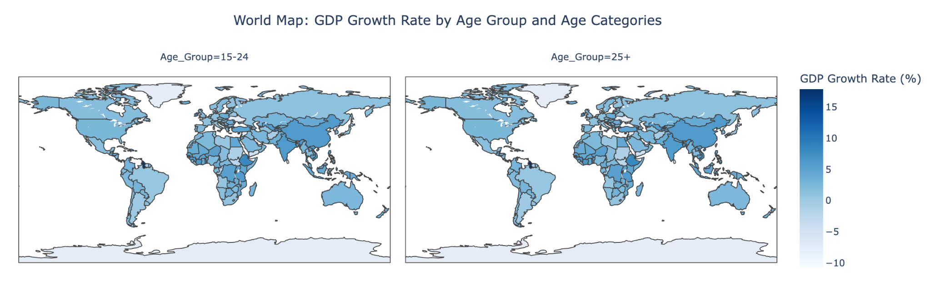
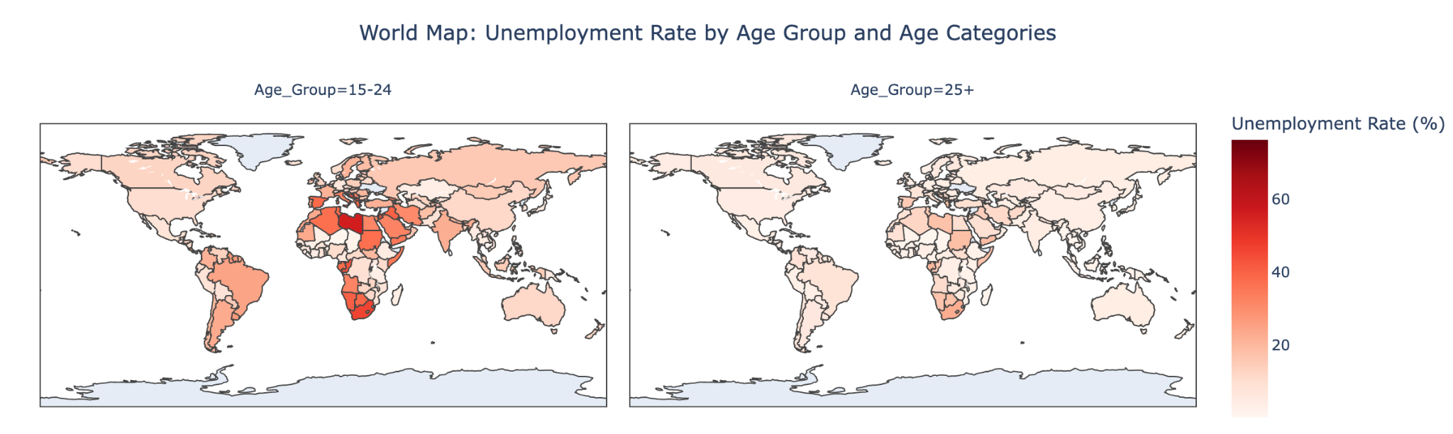
World Map
The GDP growth rates are aggregated at the national level, with no age-specific variations recorded in the dataset.
The identical color scales confirm that the GDP growth rate is not influenced by age group within the dataset.
Examples: Ethiopia (8.16%) and Australia (2.4%) show consistent GDP growth rates across both youth (15–24) and adults (25+).
The unemployment rates show significant differences between youth (15–24) and adults (25+) across countries.
Youth unemployment is consistently higher than adult unemployment
Examples:
Argentina: Youth unemployment is 23.06%, while for adults, it is 6.39%
Germany: Youth unemployment stands at 6.62%, compared to 3.42% for adults.

Slide 32
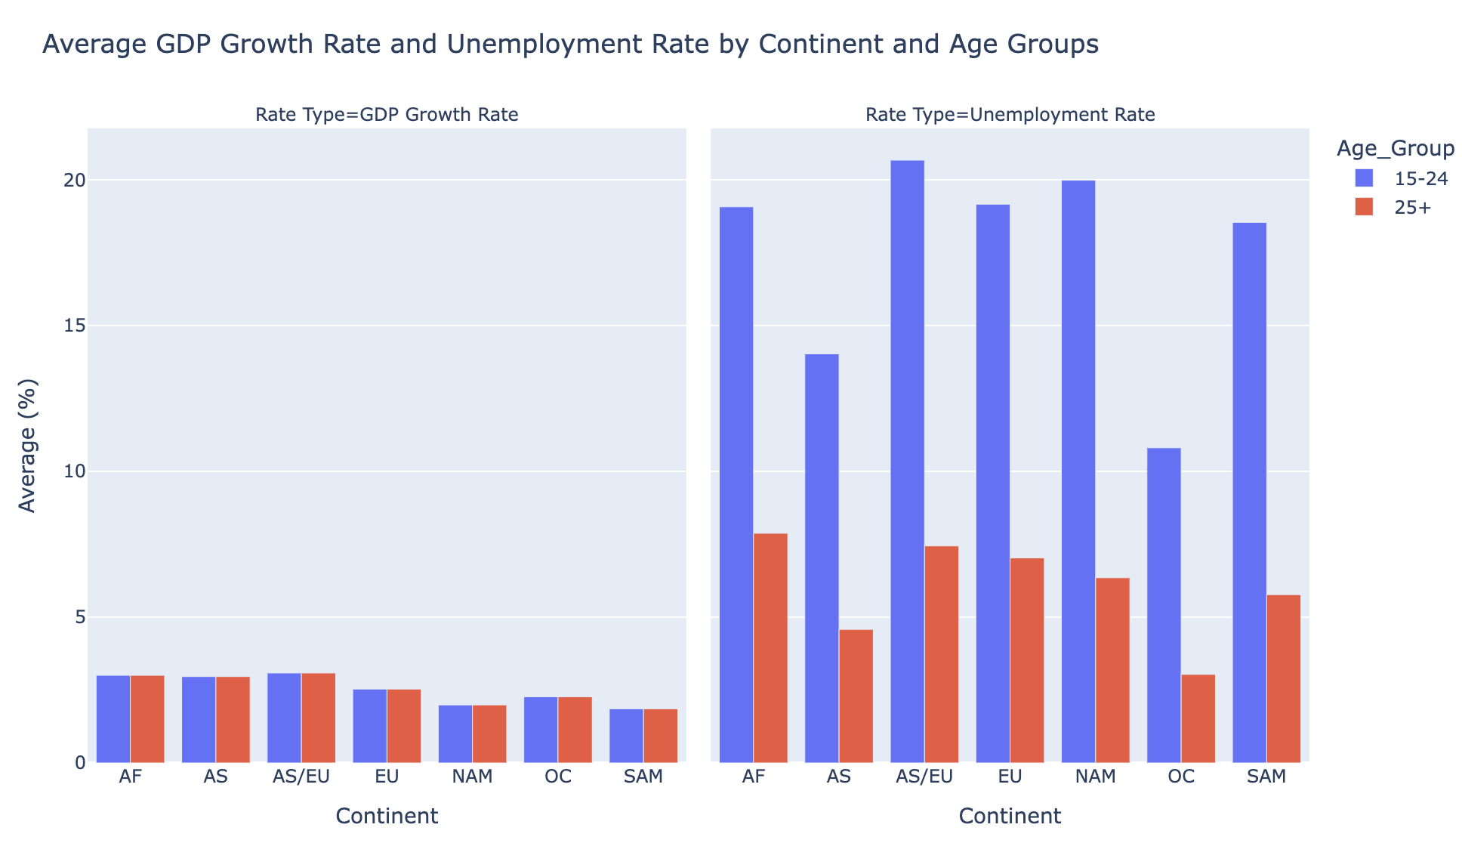
Average GDP Growth Rate and Unemployment Rate by Continent
GDP Growth Rate:
The GDP growth rates are consistent across both age groups for all continents, indicating that GDP is not significantly influenced by age demographics.
Asia: 2.96% for both Youth (15–24) and Adults (25+).
Unemployment Rate:
Unemployment rates for Youth (15–24) are substantially higher than for Adults (25+) across all continents.
North America: 19.99% for Youth compared to 6.35% for Adults.

Slide 33
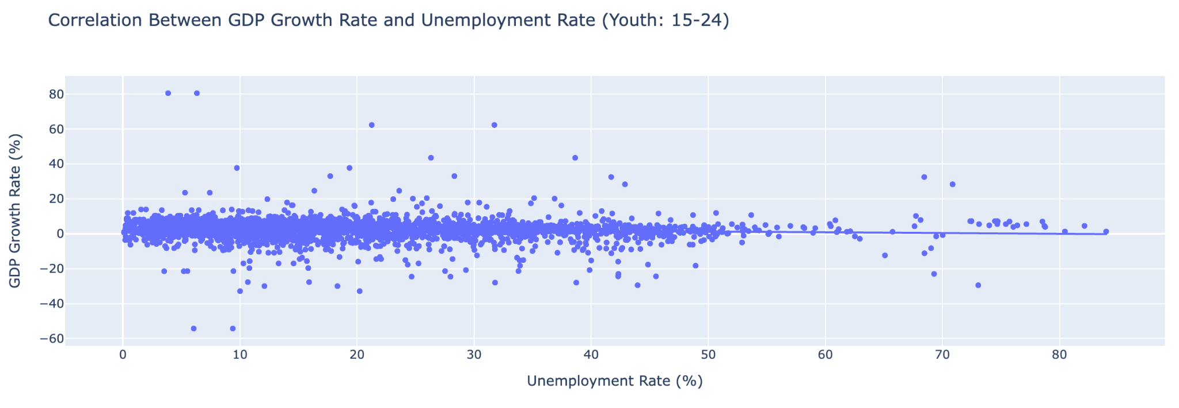
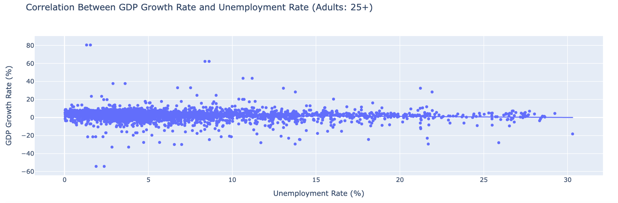
Correlation Analysis
Key Points:
Correlation Results:
For youth (15–24), the correlation coefficient is -0.101, indicating a very weak negative relationship between GDP growth rates and unemployment rates.
For adults (25+), the correlation coefficient is -0.107, also showing a very weak negative relationship.
Visual Insights:
Scatter plots with trend lines for both age groups demonstrate a near-flat trend, emphasizing the weak correlation.
Conclusion:
The data indicates that changes in GDP growth rates have minimal influence on unemployment rates across both youth and adult age groups.

Slide 34
05.
regression

Slide 35
Comparison of Models across regions
Panel ols
Hausman Test
determination
The Hausman Test was utilized to determine whether to use Fixed Effects (FE) or Random Effects (RE).
It tells us whether the unobserved effects (like country-specific factors) are correlated with the independent variable (Unemployment Rate).
To control for both individual-specific and time-specific effects, Panel OLS was used, allowing for the analysis of how variables change across both entities and time, while accounting for unobserved heterogeneity.
Hausman Statistic (58.3342): indicates a significant difference between the FE and RE coefficients.
The p-value found was essentially 0, means the difference in coefficients is statistically significant. You reject the null hypothesis, confirming that the Fixed Effects model is better.

Slide 36
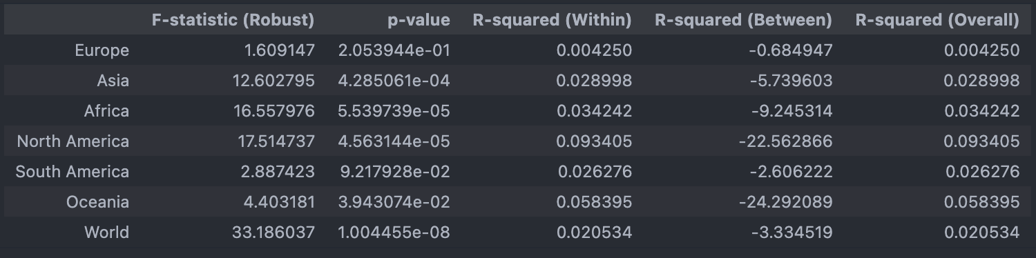
Comparison of Models across regions

Slide 37
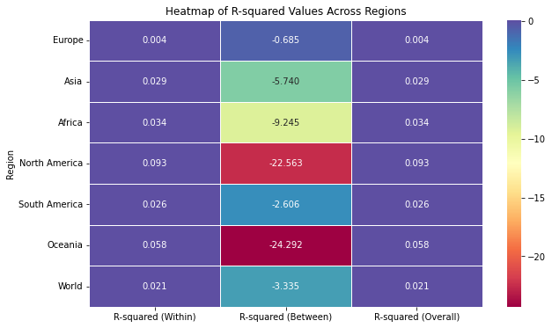
Heatmap comparing the different R-Squared Values
R-squared (within) and R-squared (overall) have minimal variation across the different regions, with values close to 0: unemployment rate poorly explains GDP growth both within individual countries over time and across all regions combined
R-squared (Between) exhibits high variation across the different regions:
Highly negative values for North America and Oceania → Insufficient Between-Country Variation or Homogeneity of Economic Structures
Close to 0 value for Europe → Model is neither good nor terrible, Diverse Economies in a Common Framework and the presence of Structural Economic Differences between Countries

Slide 38
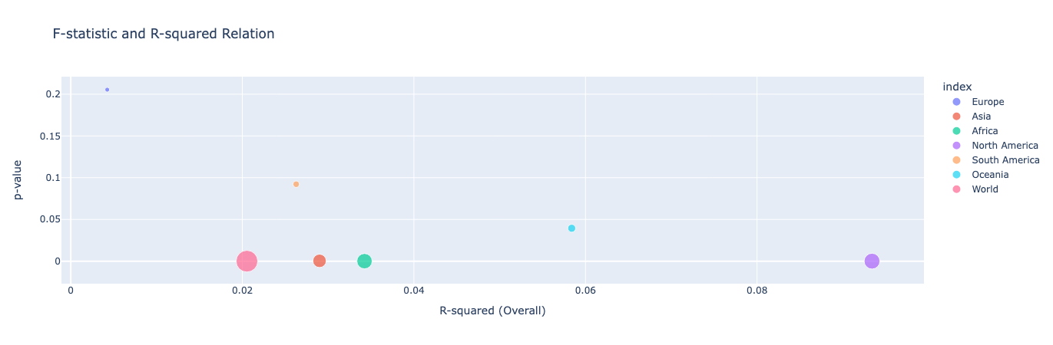
Bubble Chart for F-statistic, p-value and R-squared (Overall)
Larger bubbles indicate a higher F-Statistic which means World has the higher F-statistic followed by North America, Africa and Asia
Regions with low p-values also seem to have larger F-statistic values
North America's data suggests a moderately better model fit than other regions (highest R², statistically significant and relatively higher F-statistic

Slide 39
06.
conclusion

Slide 40

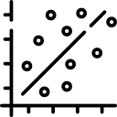
Key findings
overall trends
Correlation
Global Economic events impact all continents, with variations in economic recovery influenced by geographical region, land size, and government policies, while GDP growth rates were similar within continents, unemployment rates varied, suggesting other factors contribute significantly to GDP performance.
There is a negative correlation between GDP growth rate and unemployment rate in most of the countries. The positive correlation in AS/EU and SAM areas can be attributed to high agricultural Employment Share, high proportion of informal employment, increase unpaid family labor and labor market protection

Slide 41



Key findings
Sex & Age group
regression
Overall GDP growth was similar across all groups, even as females and youth faced higher unemployment, the correlation between unemployment and GDP growth was weak. This suggests that while groups face greater employment challenges, these do not strongly influence overall growth. Other factors likely have a more decisive impact on GDP trends.
The regression analysis indicates that while the unemployment rate weakly predicts GDP growth, regional economic characteristics and other factors play a more significant role in shaping economic performance.

Slide 42




Future work
01
02
Include other independent variables that affect Real GDP such as consumer spending, business investment, government expenditure, etc.
Find data for Real GDP growth rates sex and age group specific
03
04
Utilize dynamic modeling to capture the time-lagged and reciprocal effects between unemployment and real GDP growth
Explore how global economic shocks, like COVID-19 or financial crises, impact the relationship between unemployment and real GDP growth across regions and demographics

Slide 43
THANK
You!

Slide 44
annex

Slide 45
Metrics used for comparison
F-statistic (Robust)
p-value
R-Squared (Within)
R-Squared (between)
R-Squared (overall)
Model as a whole explains a significant amount of variation in the dependent variable.
Statistical significance of the relationship between the unemployment rate and GDP growth.
Measure how well the independent variable explains the variation within entities (e.g., countries or regions) over time.
Measure how well the independent variable explains the variation in the dependent variable between groups or entities (e.g., countries)
Measure how well the independent variable explains the total variation in the dependent variable across both time and groups

Slide 46

Video presentation

